Slide 1


Online Course Registration System.
By:
K . Md. Zahid Parvez(076)
Md. Shadab Hussain(082)
C. Shashank(107)

Slide 2
Actors Wise Use Cases.
USER
User Window
Display Courses
Course Selection
Course Registration
Online Examination
Admin
Display User Details
Add New Course
Online Examination
Remove Course

Slide 3
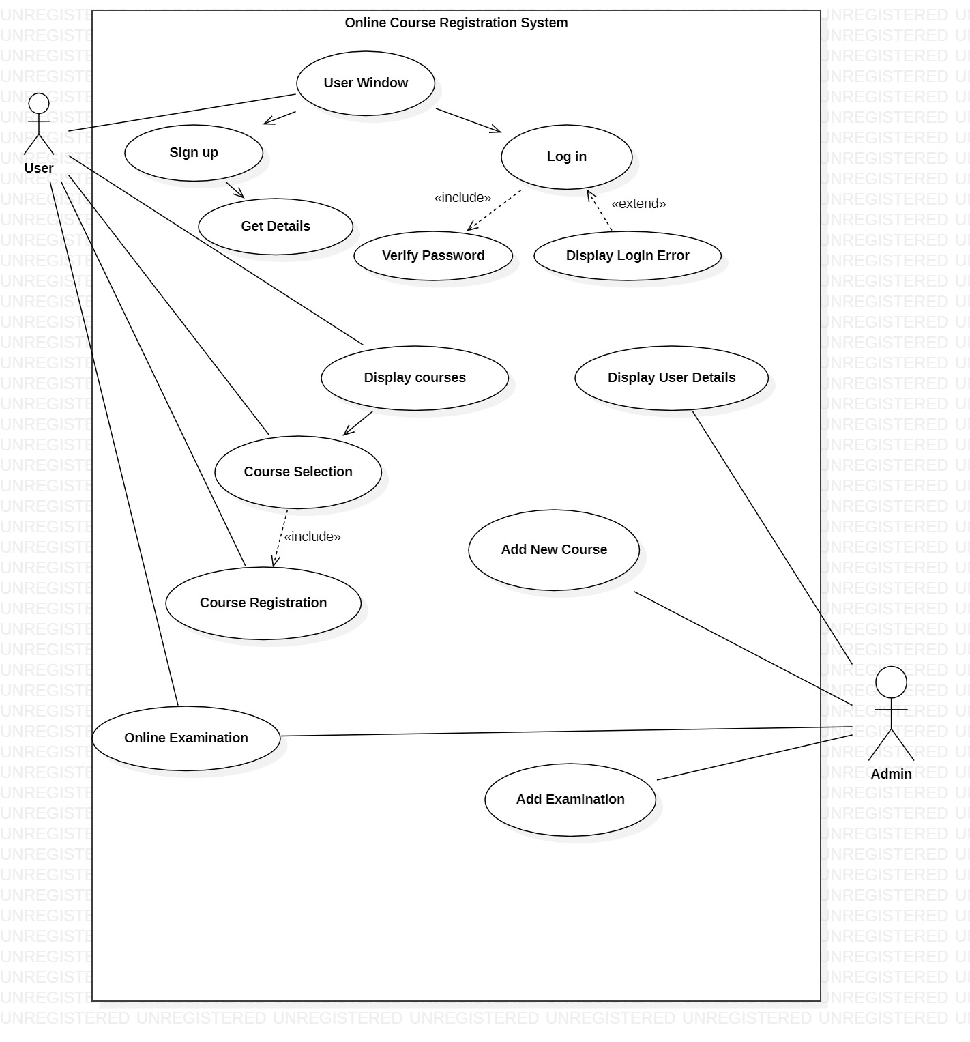
Use Case Diagram

Slide 4



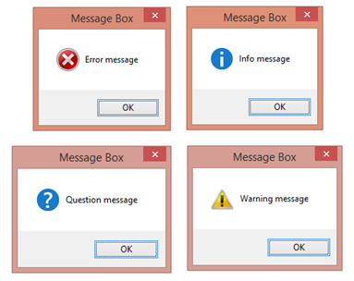
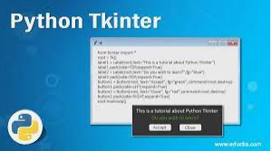
Technology Used
Tkinter
Json
Message-box
Smtplib
Mysql
Openpyxl
Random module

Slide 5
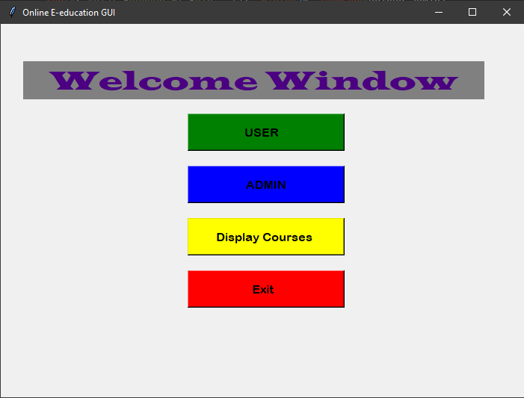
Welcome Window

Slide 6
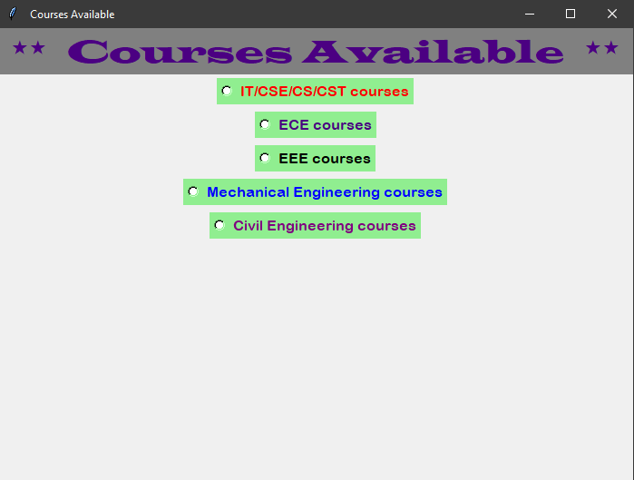
Display Courses

Slide 7
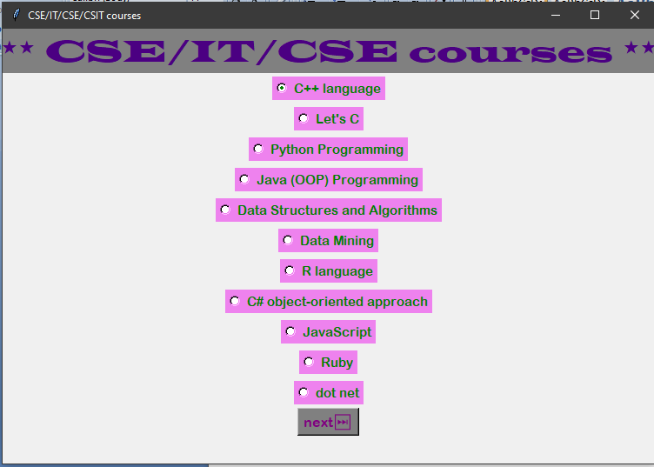
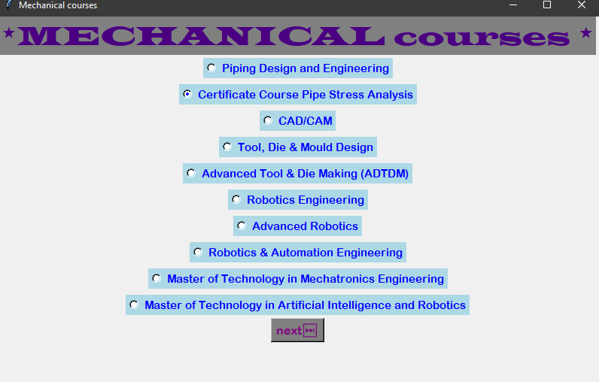
Display Courses

Slide 8
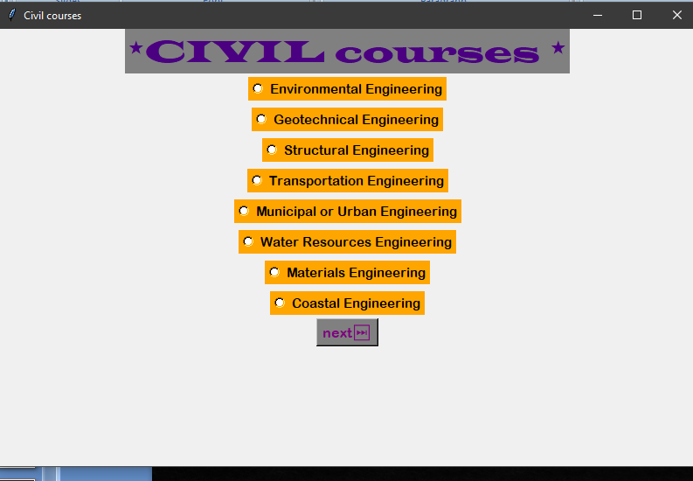

Slide 9
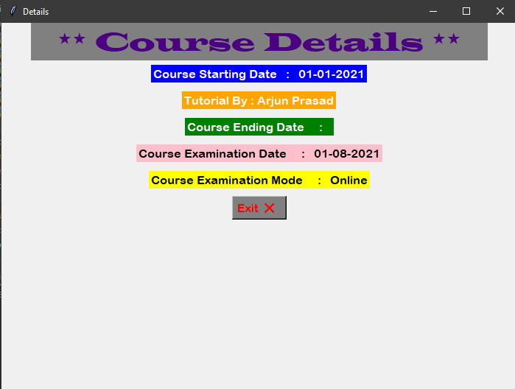
Courses Details

Slide 10
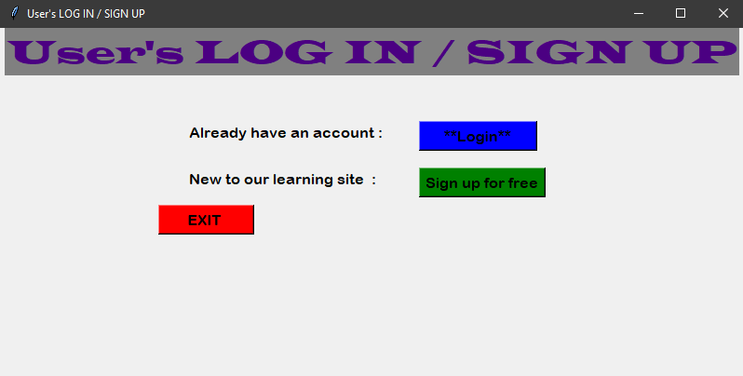
USER

Slide 11
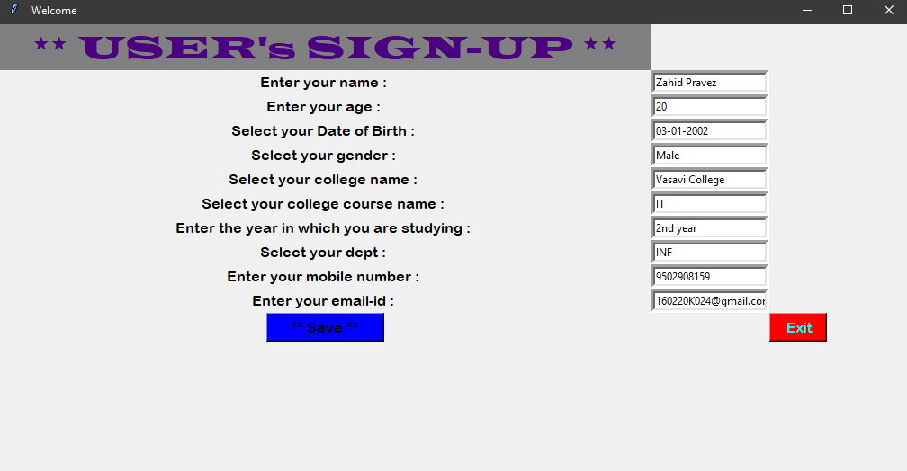
SIGN-UP

Slide 12
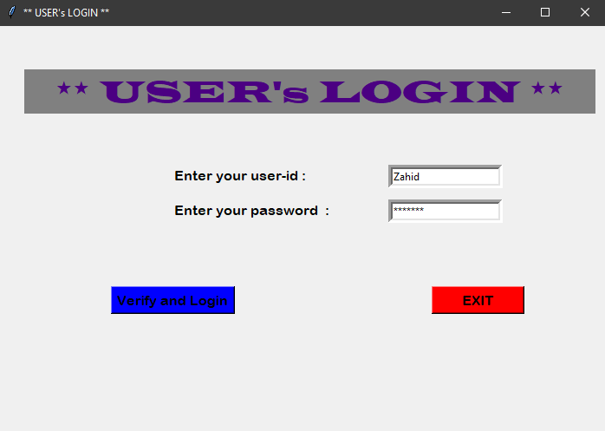
After the successful registration, email will be sent to the registered email regarding login details.

Slide 13
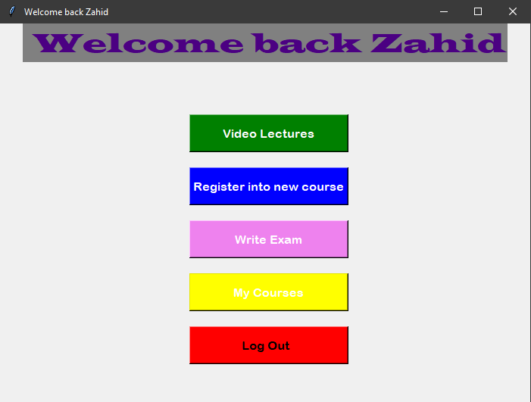
Logged in user window

Slide 14
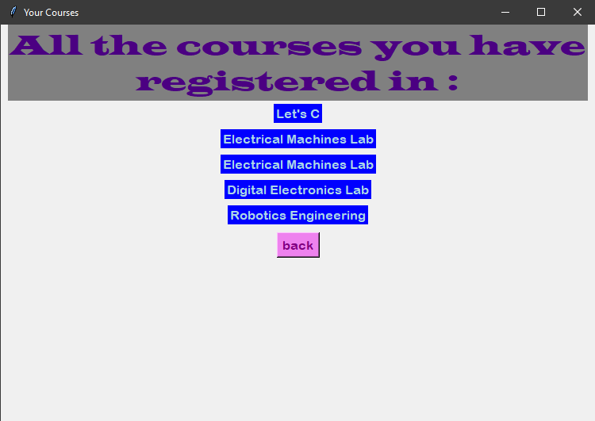
My Courses

Slide 15
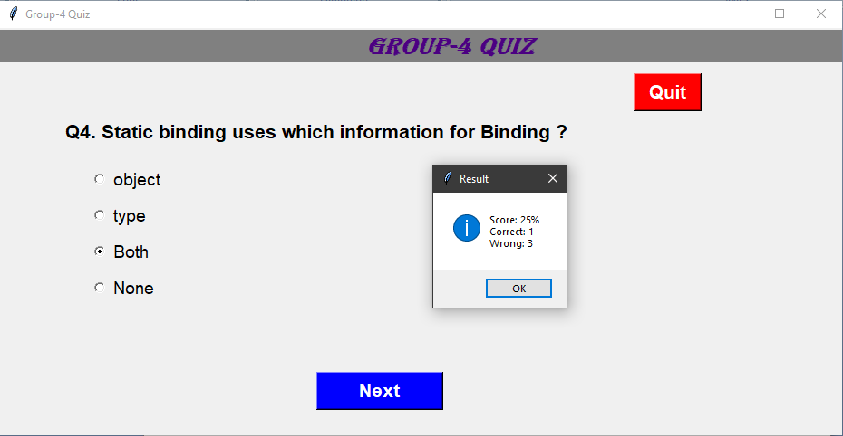
Write exam

Slide 16
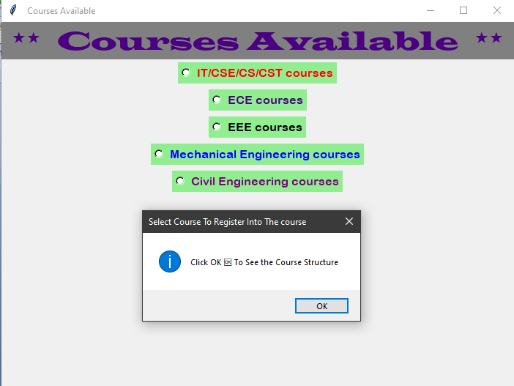
Register into a new course.

Slide 17
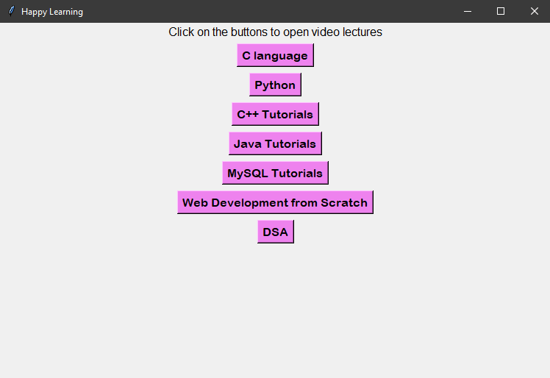
Video lectures

Slide 18
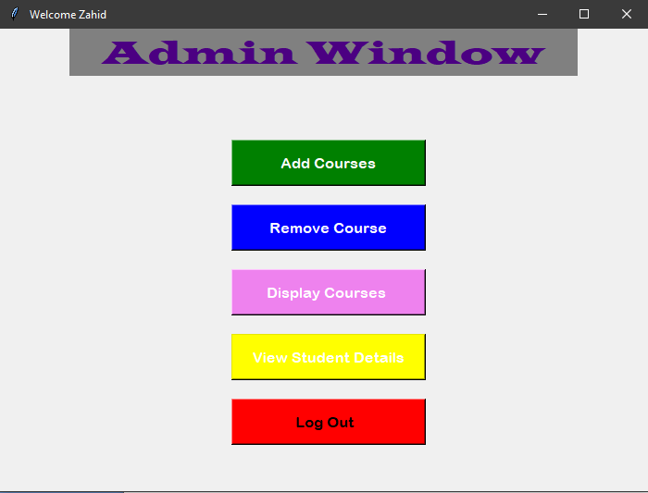
Admin

Slide 19
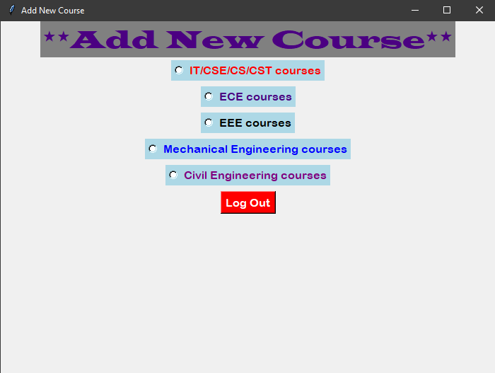
Add New Course

Slide 20
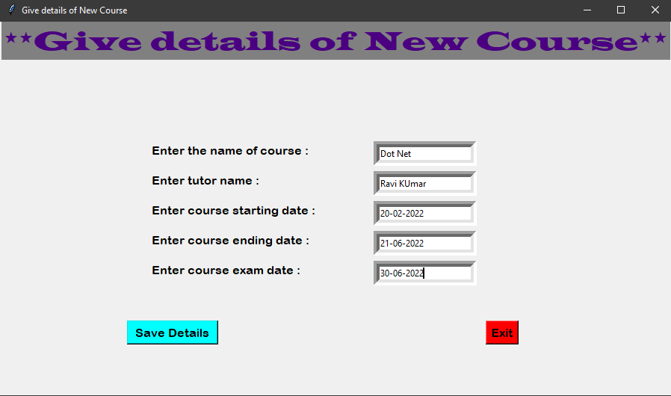

Slide 21
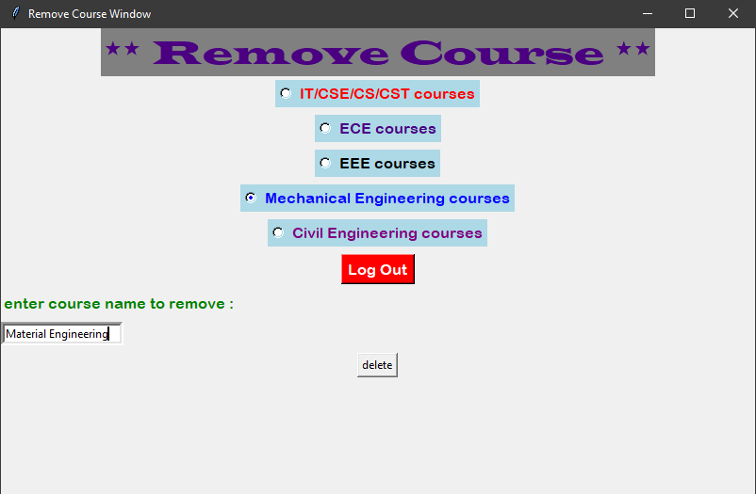
Remove Course

Slide 22
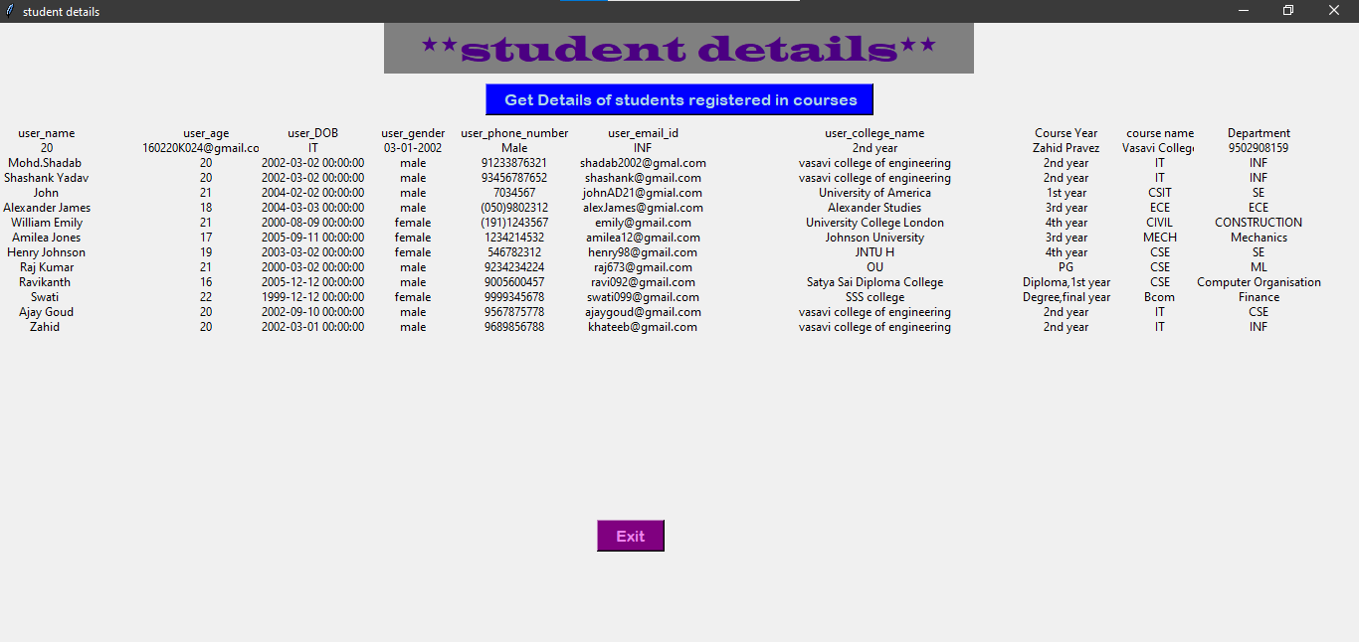
View Student Details

Slide 23
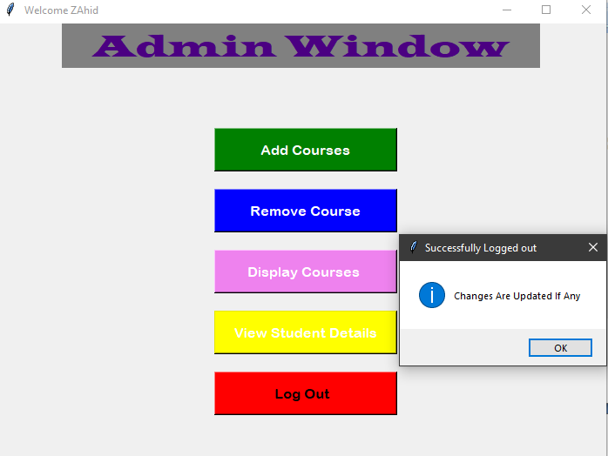
Log Out

Slide 24
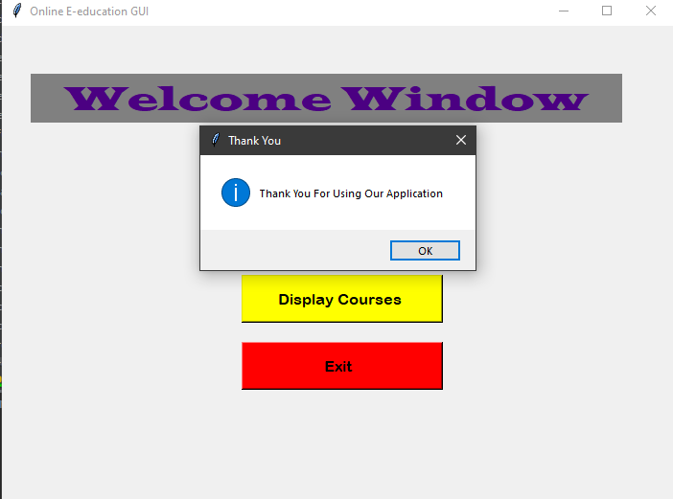
Exit

Slide 25
Conclusion and future work.
Our project focuses on providing web interface for applying for Online courses and taking exams for students.
Our goal is to make our project available for everyone through the internet using Django and Databases that will be our upcoming goal for our application.

Slide 26


